Slide 1

AbleBond: Building Bonds Beyond Barriers
AbleBond is a gamified app designed to reduce social isolation for disabled individuals. Our platform goes beyond traditional social networking, creating a vibrant community where friendships flourish and barriers dissolve. By harnessing the power of gamification for social change. AbleBond transforms the way disabled and abled individuals connect, interact, and build lasting relationships.
BY TEAM CIPHER

Slide 2

The Challenge of Social Isolation
Emotional Impact
Social Barriers
Social isolation often surpasses the challenges of disability itself, leading to depression and anxiety.
Limited accessible spaces and lack of inclusive platforms hinder the formation of meaningful friendships.
Societal Misconceptions
Digital Divide
Many existing social platforms lack comprehensive accessibility features, further isolating disabled individuals.
Misconceptions about disabilities create additional barriers to social integration and understanding.

Slide 3
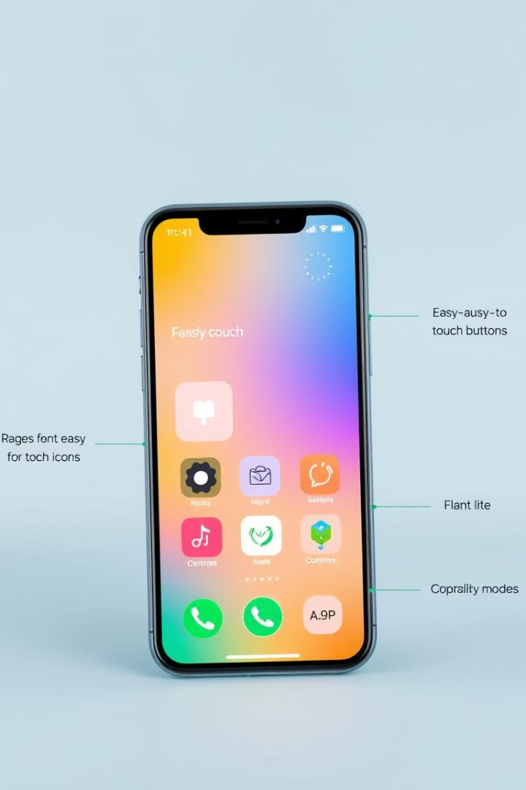
AbleBond: Our Innovative Solution
1
Connect
Users create profiles highlighting their interests, abilities, and accessibility needs, fostering connections based on shared experiences and passions.
2
Engage
Participate in gamified friendship-building missions and inclusive events, earning rewards and building relationships through shared experiences.
3
Grow
Track progress, unlock achievements, and expand social circles while developing empathy and understanding across diverse abilities.
4
Thrive
Experience reduced social isolation, improved mental well-being, and a stronger sense of community and belonging.

Slide 4
Core Features of AbleBond
Inclusive Registration
Friendship Missions
Accessible Communication
User-friendly interface accommodating various needs. Disabled users specify interests and accessibility requirements, while abled users share skills and support areas.
Daily challenges designed for collaborative completion, encouraging interaction and bonding across abilities.
Chat and video functionalities with text-to-speech, captions, and image descriptions ensure inclusive conversations.

Slide 5
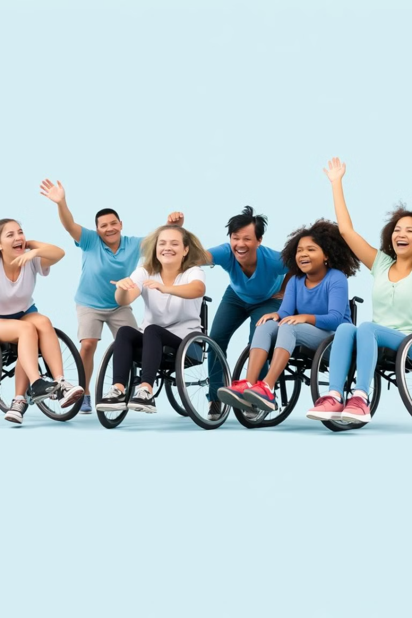




Unique Features for Reducing Isolation
Adaptive Matching
Creative Workshops
AI-driven algorithm pairs users based on shared interests and accessibility preferences.
Art therapy and storytelling clubs for
self-expression and collaborative creativity.
Adaptive Sports
Virtual Experiences
Inclusive activities like seated volleyball and boccia to promote physical engagement.
Immersive VR activities for home-based engagement and exploration.

Slide 6
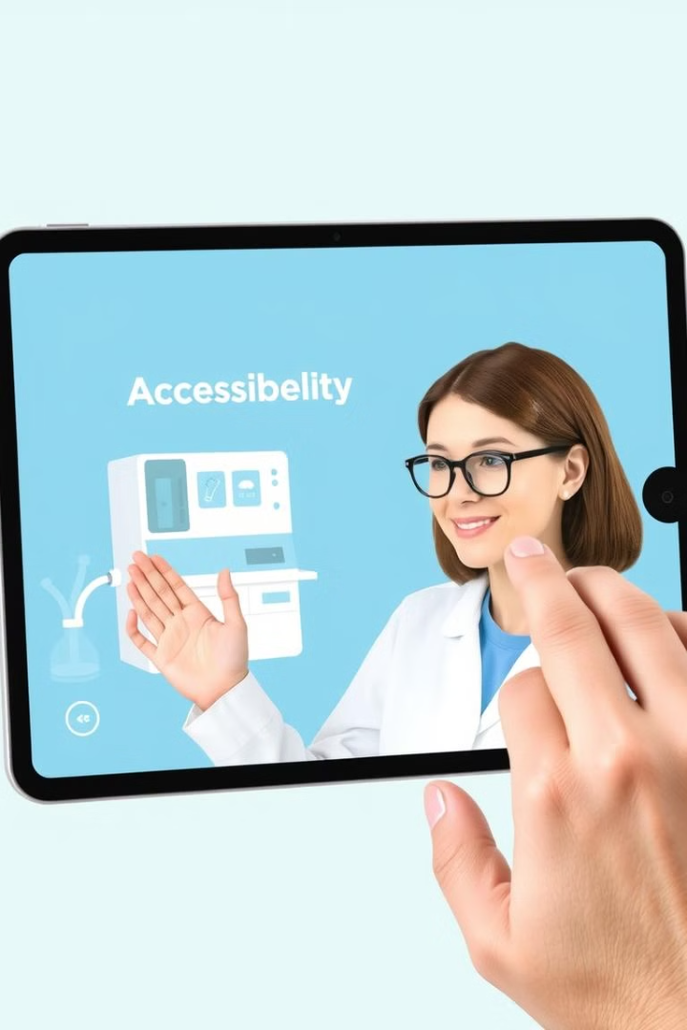




Enhancing Engagement and Empathy
Friendship Insights
Track user engagement and friendship growth, providing personalized suggestions for new activities and connections.
Virtual Accessibility Lab
Simulations allow non-disabled users to experience challenges faced by disabled individuals fostering empathy and understanding.
Achievements Journal
Document friendship journeys with guided prompts for reflection, encouraging deeper connections and personal growth.
Buddy Mentor System
Experienced users support newcomers, creating a welcoming community and smoother onboarding experience.

Slide 7
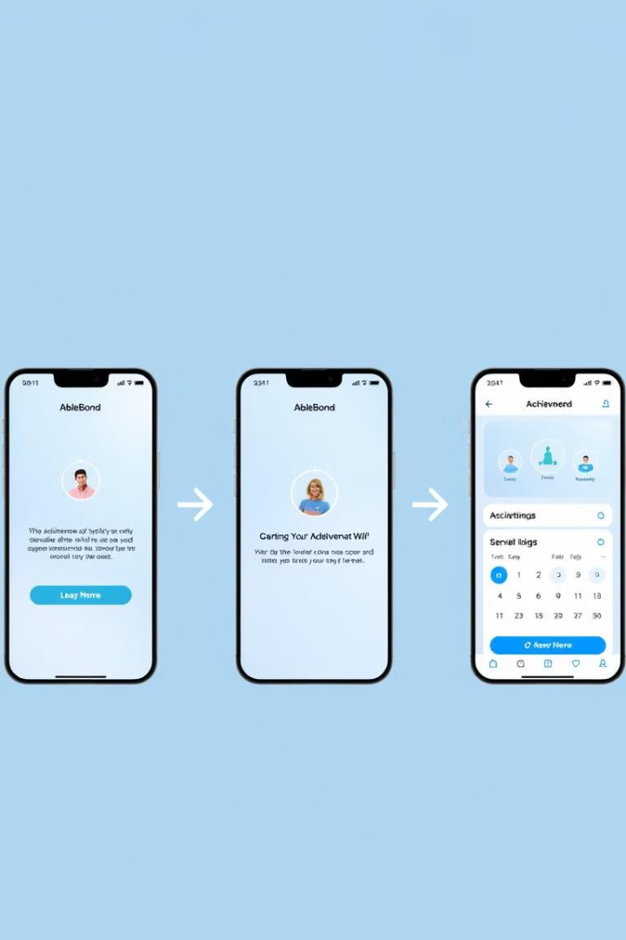
User Flow and Interface
1
Onboarding
Intuitive profile creation process, guiding users through interest selection and accessibility preferences.
2
Friendship Matching
AI-powered algorithm suggests potential connections based on shared interests and compatibility.
3
Daily Missions
Engage users in inclusive activities and events, promoting regular interaction and relationship building.
4
Achievements Dashboard
Visual representation of progress, showcasing earned badges and milestones in the user's friendship journey.

Slide 8
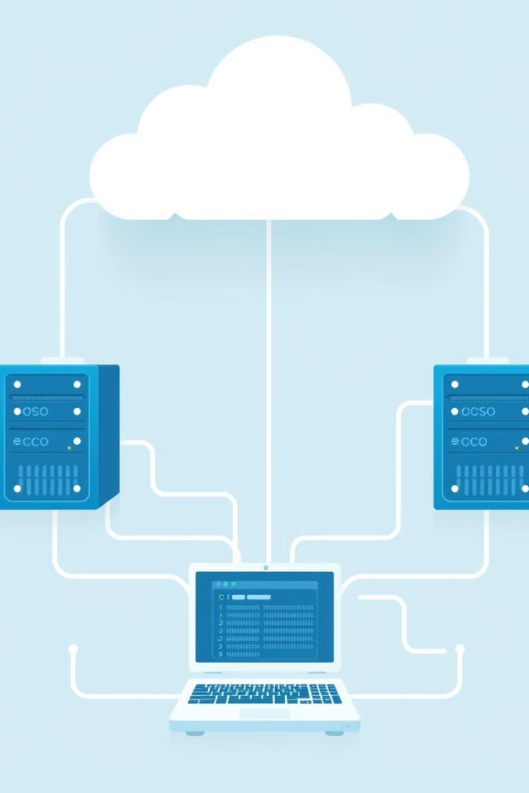
Technical Implementation
Backend
Node.js for real-time data management and user profiles
Frontend
React Native for cross-platform accessibility
AI Integration
Machine learning for adaptive matching and user insights
Accessibility
WCAG 2.1 compliance, screen reader compatibility
Security
End-to-end encryption for user data protection
Scalability
Cloud-based infrastructure for seamless growth

Slide 9
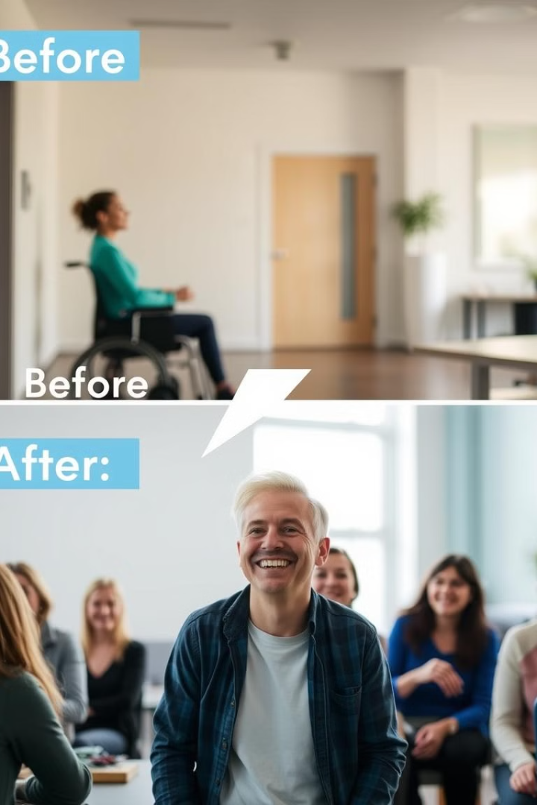
Expected Social Impact
1
Reduced Isolation
2
Increased Awareness
The app targets a 50% increase in disability awareness among non-disabled users, fostering a more inclusive society through education and shared experiences.
AbleBond aims to decrease feelings of loneliness among disabled users
3
Community Growth
4
Mental Well-being
We project an increase in local community participation for disabled individuals, facilitated by AbleBond's event features and accessibility information.
Through increased social connections and support, we aim to improve overall mental health scores for our user base.

Slide 10
Join Us in Building Bonds Beyond Barriers
AbleBond is more than just an app; it's a movement towards a more inclusive, understanding, and connected world. By harnessing the power of gamification and technology, we're not only reducing social isolation but also fostering a community where friendships thrive regardless of ability.
As we conclude this presentation, we invite you to envision the profound impact AbleBond can have on millions of lives. Together, we can break down barriers, challenge perceptions, and create a world where everyone has the opportunity to form meaningful connections. Join us in this exciting journey to transform social dynamics, empower individuals, and build a supportive community for all. With AbleBond, we're not just connecting people; we're building a more inclusive future, one friendship at a time.

